Slide 1

Lecture 7 - Architecture Styles Part 2

Slide 2

Architecture

Slide 3
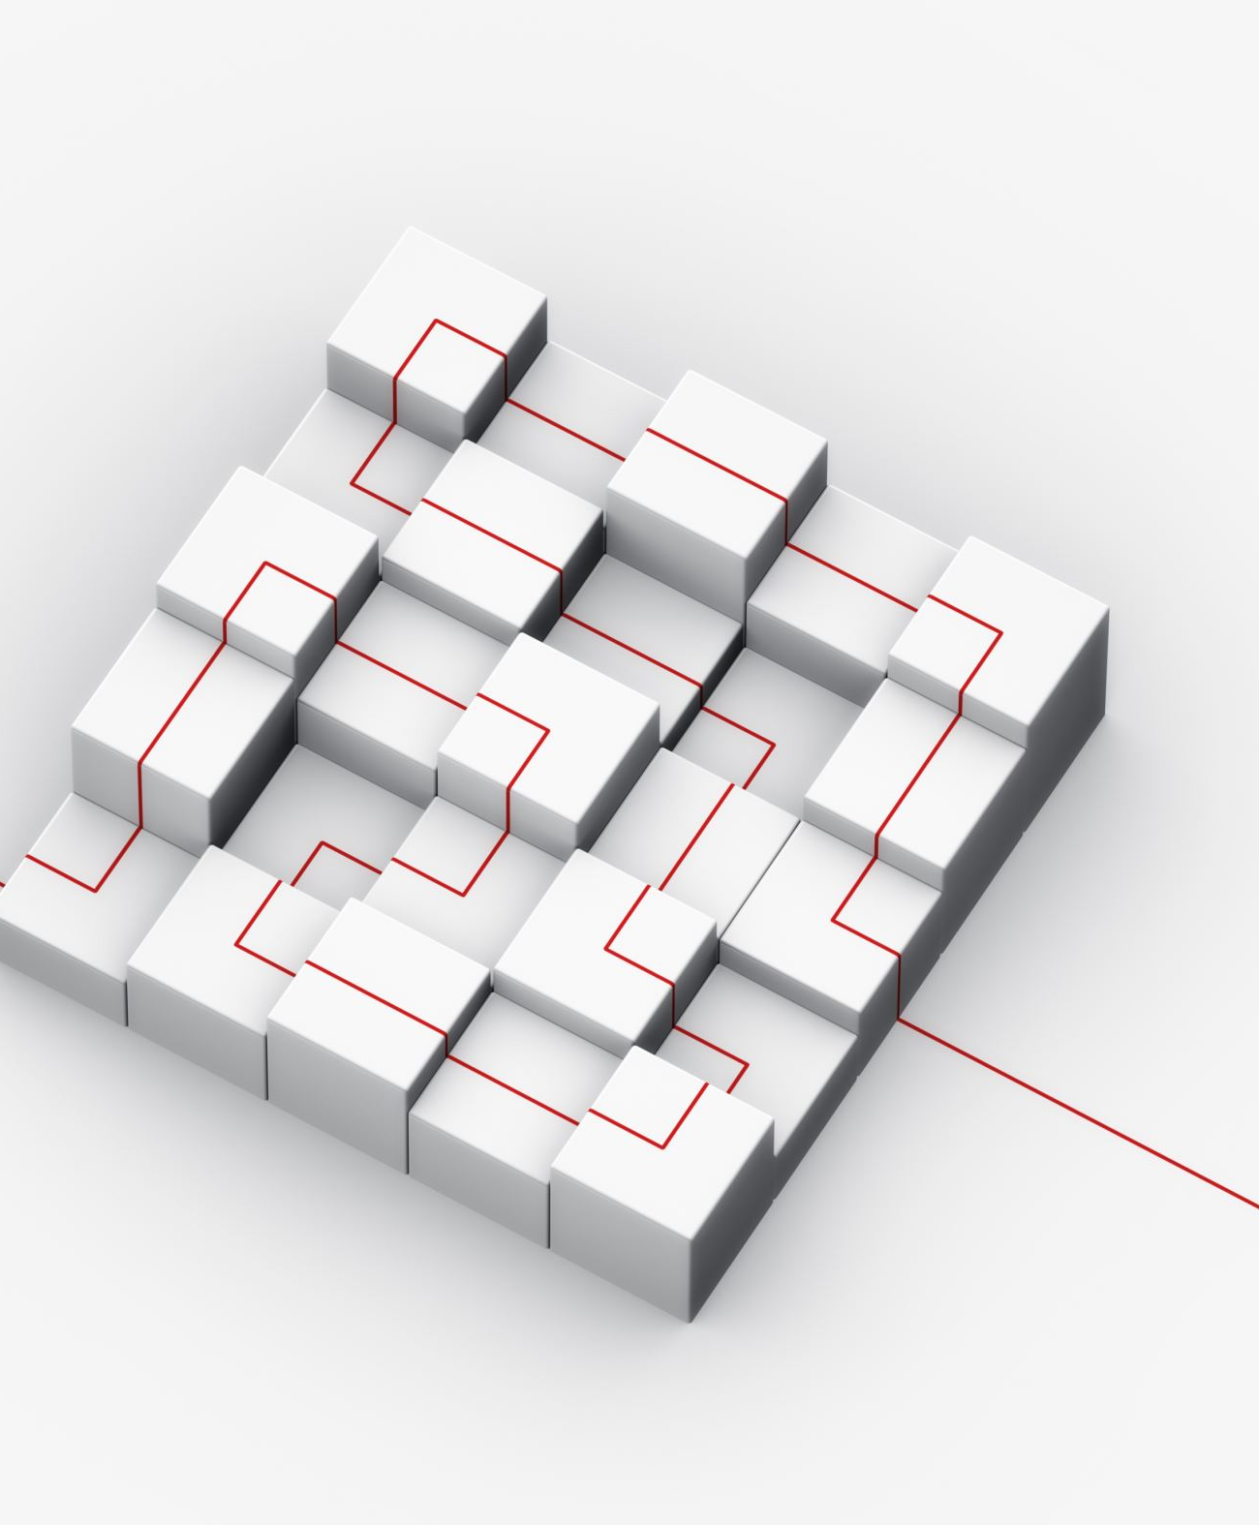
Recap
Architectural Styles I
Monolithic
Client-Server
Multi-Tier Models
Representational State Transfer
Peer-to-Peer

Slide 4

Today’s Topics
Architectural Styles II:
Pipe-and-Filter
Model-View-Controller
Event-Driven Architecture
Microkernel
Microservices

Slide 5
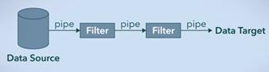
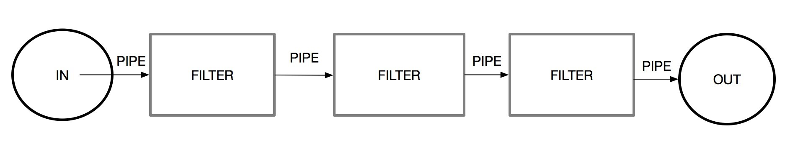
Pipe-and-Filter
Pipe-and-Filter architecture, also called pipeline architecture, refers to a sequential chain of components such that the output of one component is the input of the next component
Functional components are called filters
Connections between filters are called pipes

Slide 6
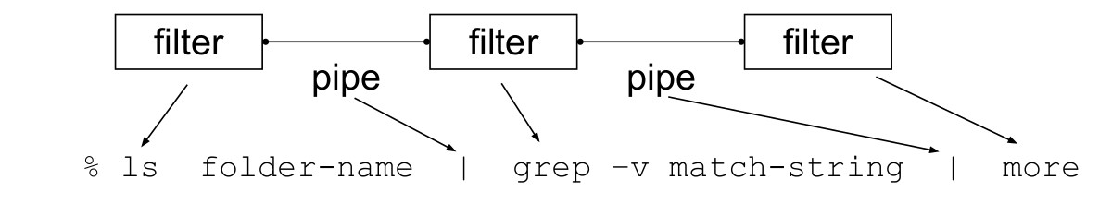
Pipe-and-Filter example
Example: UNIX shell commands
ls – lists all files and directories in the specified directory
grep – searches for all lines containing a given string

Slide 7
Pipe-and-Filter example
Example: UNIX shell commands
ls – lists all files and directories in the specified directory
grep – searches for all lines containing a given string

Slide 8
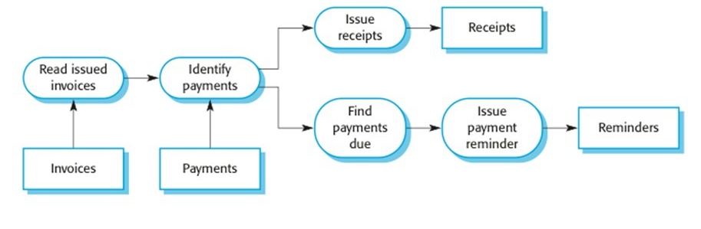
Pipe-and-Filter example
Example: Simple invoice system

Slide 9
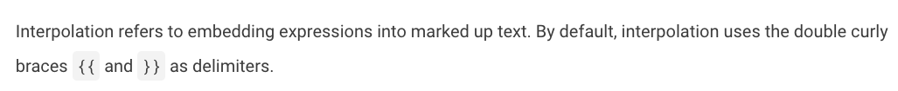
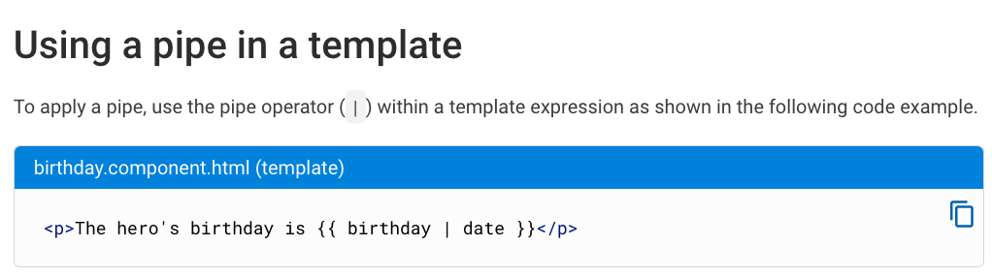
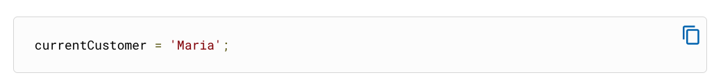
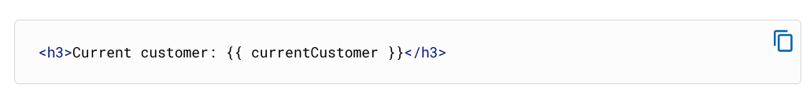
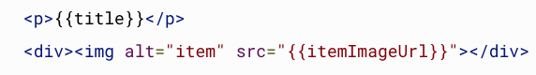
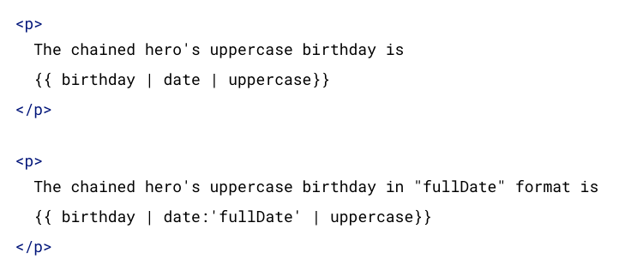
Pipe-and-Filter example
Angular Pipes

Slide 10

Pipe-and-Filter
Pros
Easy to understand and link to business practices
Can reuse components
Easy to extend by adding new components
Can be sequential or concurrent
Cons
Very hard to make interactive
Performance bottlenecks

Slide 11

Model-View-Controller (MVC)
Model-View-Controller architecture separates a software system into three components
The model manages data, business rules and system logic
The view presents the model to the user, and includes the user interface
The controller accepts user input and passes it to the model

Slide 12
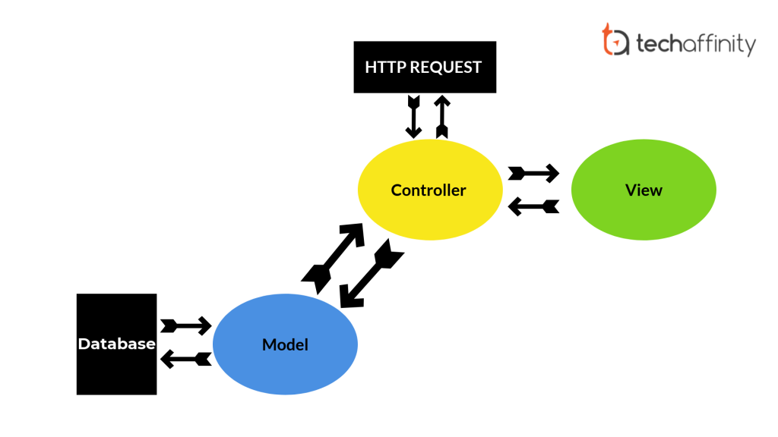
MVC Example
Example: A web application
Model – a database, stored on the server
View – HTML rendered on the client’s browser
Controller – a JavaScript script passed from the server to the client
Note: in this example, MVC architecture is imposed on a client-server model
Many real web applications may differ in how MVC is divided between client and server
Other examples: Model-View-Template in Django, ASP.NET

Slide 13
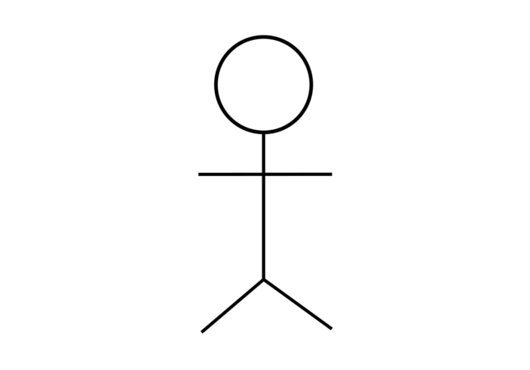
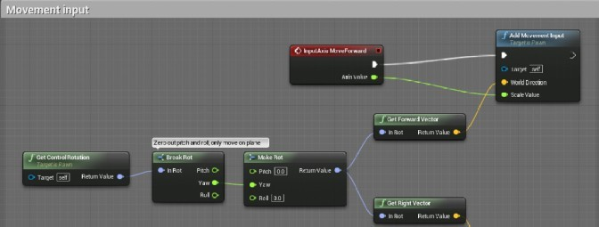



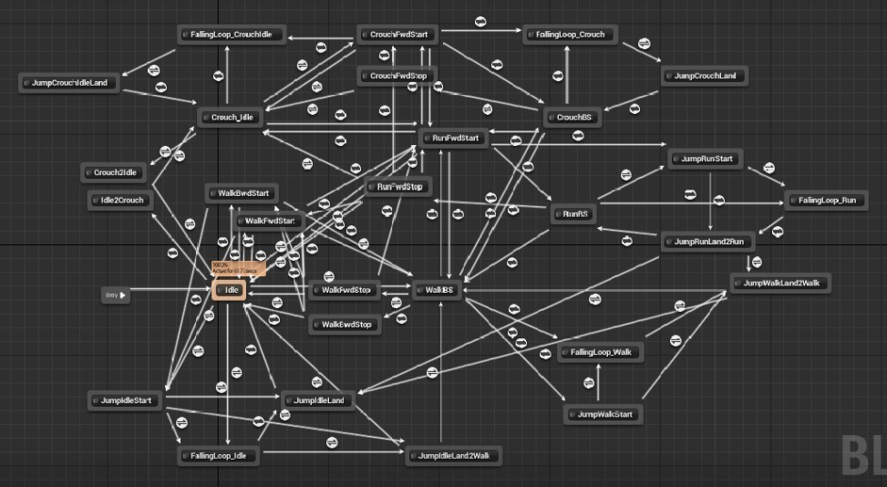

MVC Example
User
Controller
●
Example: Video games
Example: Video games
Model – game world, player state, etc
View – rendered game world, user interface, audio, etc
Controller – listens for user inputs
Note: don’t confuse with a physical controller
Model
View

Slide 14

MVC
Pros
Simultaneous development
High cohesion – related parts are grouped together
Low coupling – components are separate, interact only through specific interfaces
Easy to modify
Extensibility – multiple views
Cons
Code can become very complex
Can be difficult to maintain consistency when a feature is split between three components

Slide 15
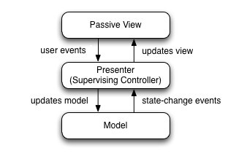
Model-View-Presenter
Variant: Model-View-Presenter – a presenter acts as an intermediary between the view and the model, which do not communicate directly
View handles user input (unlike the view in MVC)
Presenter formats model data for the view, and interprets inputs given by the view
Easier to fit into the Client-Server model
Example: many web applications, apps, etc

Slide 16
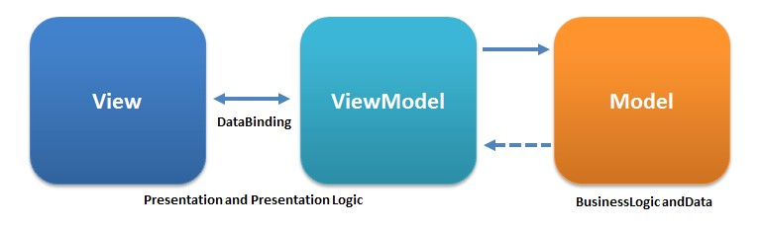
Model-View-Viewmodel
Variant: Model-View-ViewModel – a viewmodel acts as an intermediary between view and model
Unlike MVP, MVVM viewmodel does not know anything about the view
View directly binds to parts of the viewmodel using a binder
Example: Windows graphical interface (WPF)

Slide 17
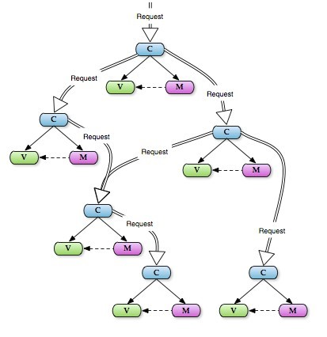
Hierarchical Model-View-Controller
Variant: Hierarchical MVC – a set of MVCs are arranged hierarchically, such that higher level controllers can communicate with lower-level controllers
Allows for dynamic control of different parts of a layout without needing to
Example: website with embedded widgets

Slide 18
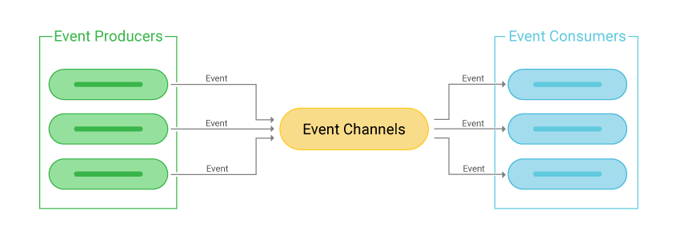
Event-Driven Architecture (EDA)
Event-Driven Architecture is an architectural style centered on events
An event is a change of state
Hardware (e.g. user presses a button, sensor detects movement, etc)
Software (e.g. state variable changes, response returned by software, etc)
Components in EDA can be producers or consumers (of events)
Event producers detect an event and emit a response
Event consumers (a.k.a. event processors) receive messages about events and react accordingly
Communication handled by event channels

Slide 19
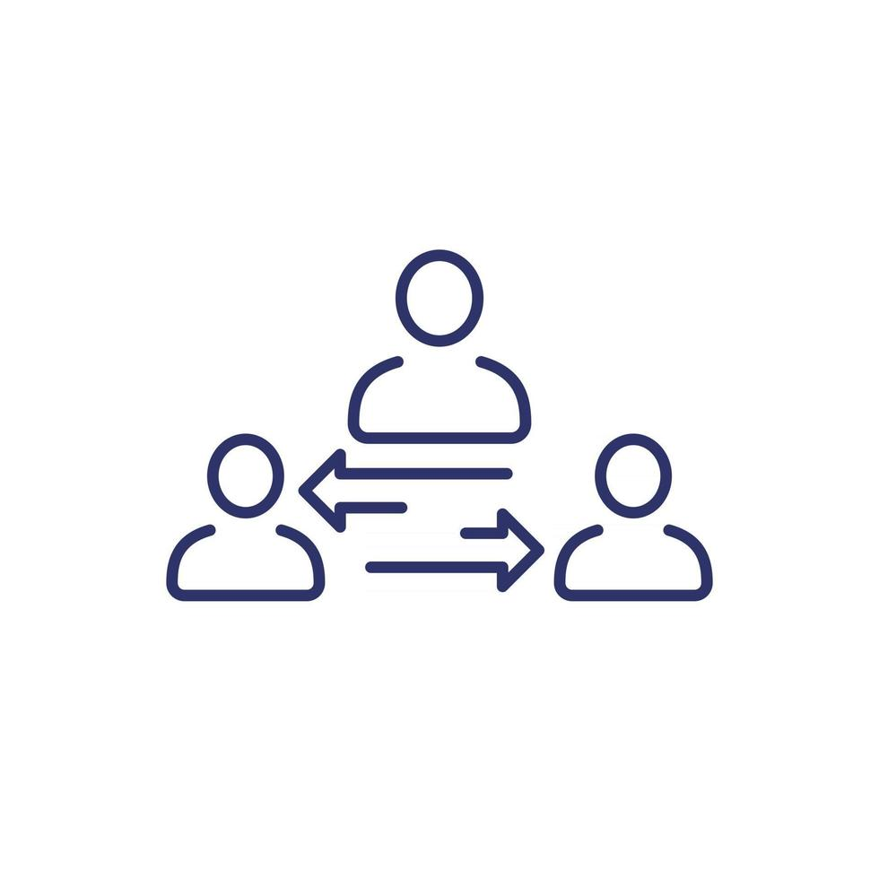
Event-Driven Architecture (EDA)
Example: security system
Producers: doors , movement sensors, cameras, etc
Consumers: alarm sound, call security, lock doors, etc
EDA can have several topologies
"topologies" refer to different structures or arrangements in which events flow and are processed within the system
Mediator
Broker

Slide 20
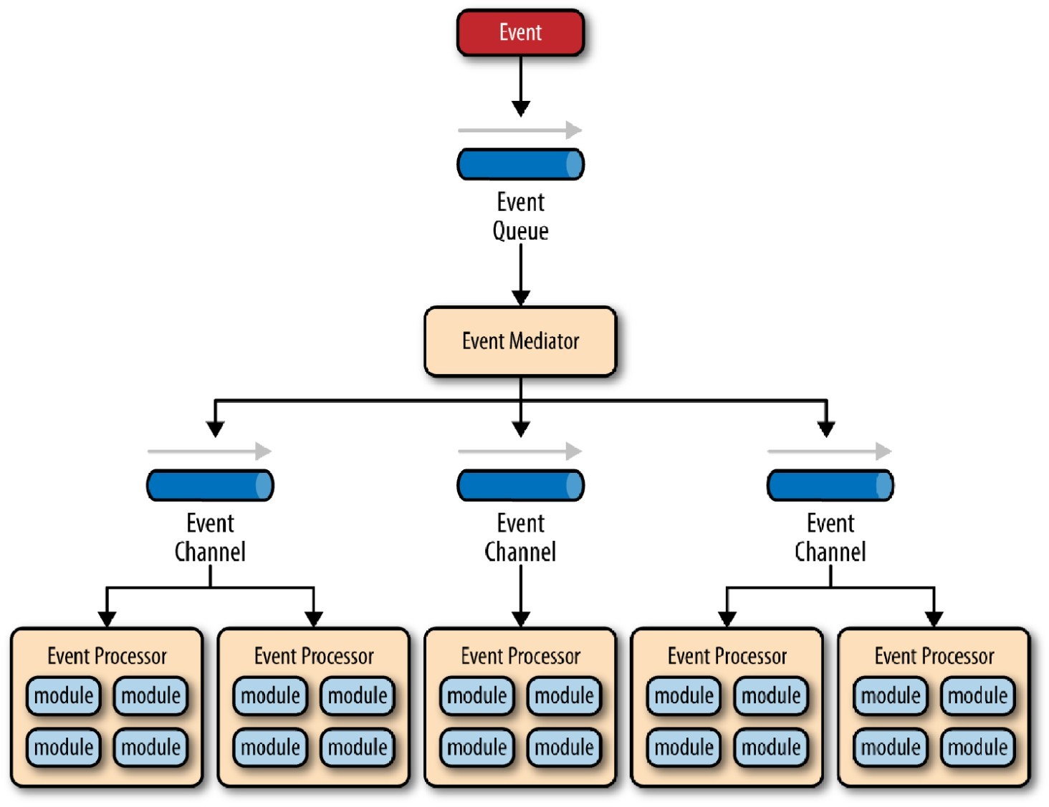
EDA: Mediator
The mediator topology consists of event producers, an event queue, an event mediator, event channels and event consumers
Event producer triggers an event
Event is passed to an event queue
Event queue passes events to an event mediator
Event mediator reads an event and passes it to the appropriate event channel
Event consumers listen to particular channels and receive events from them

Slide 21
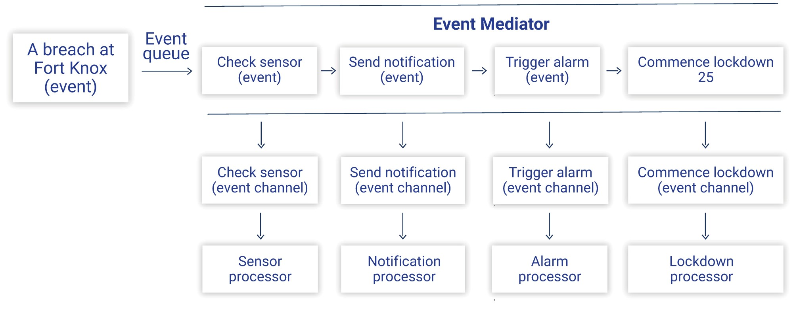
EDA: Mediator Topology Example

Slide 22
EDA: Broker Topology
The broker topology consists of a lightweight event broker that contains all event channels
No central mediator to coordinate tasks

Slide 23
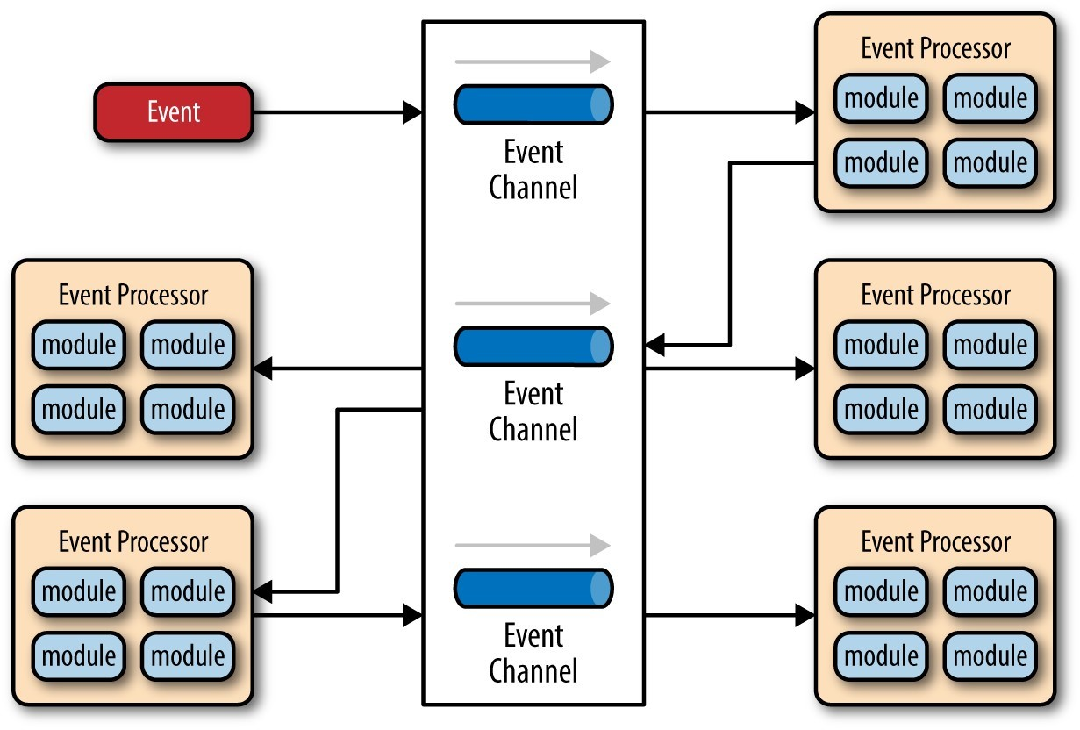
EDA: Broker Topology
The broker topology consists of a lightweight event broker that contains all event channels
No central mediator to coordinate tasks

Slide 24
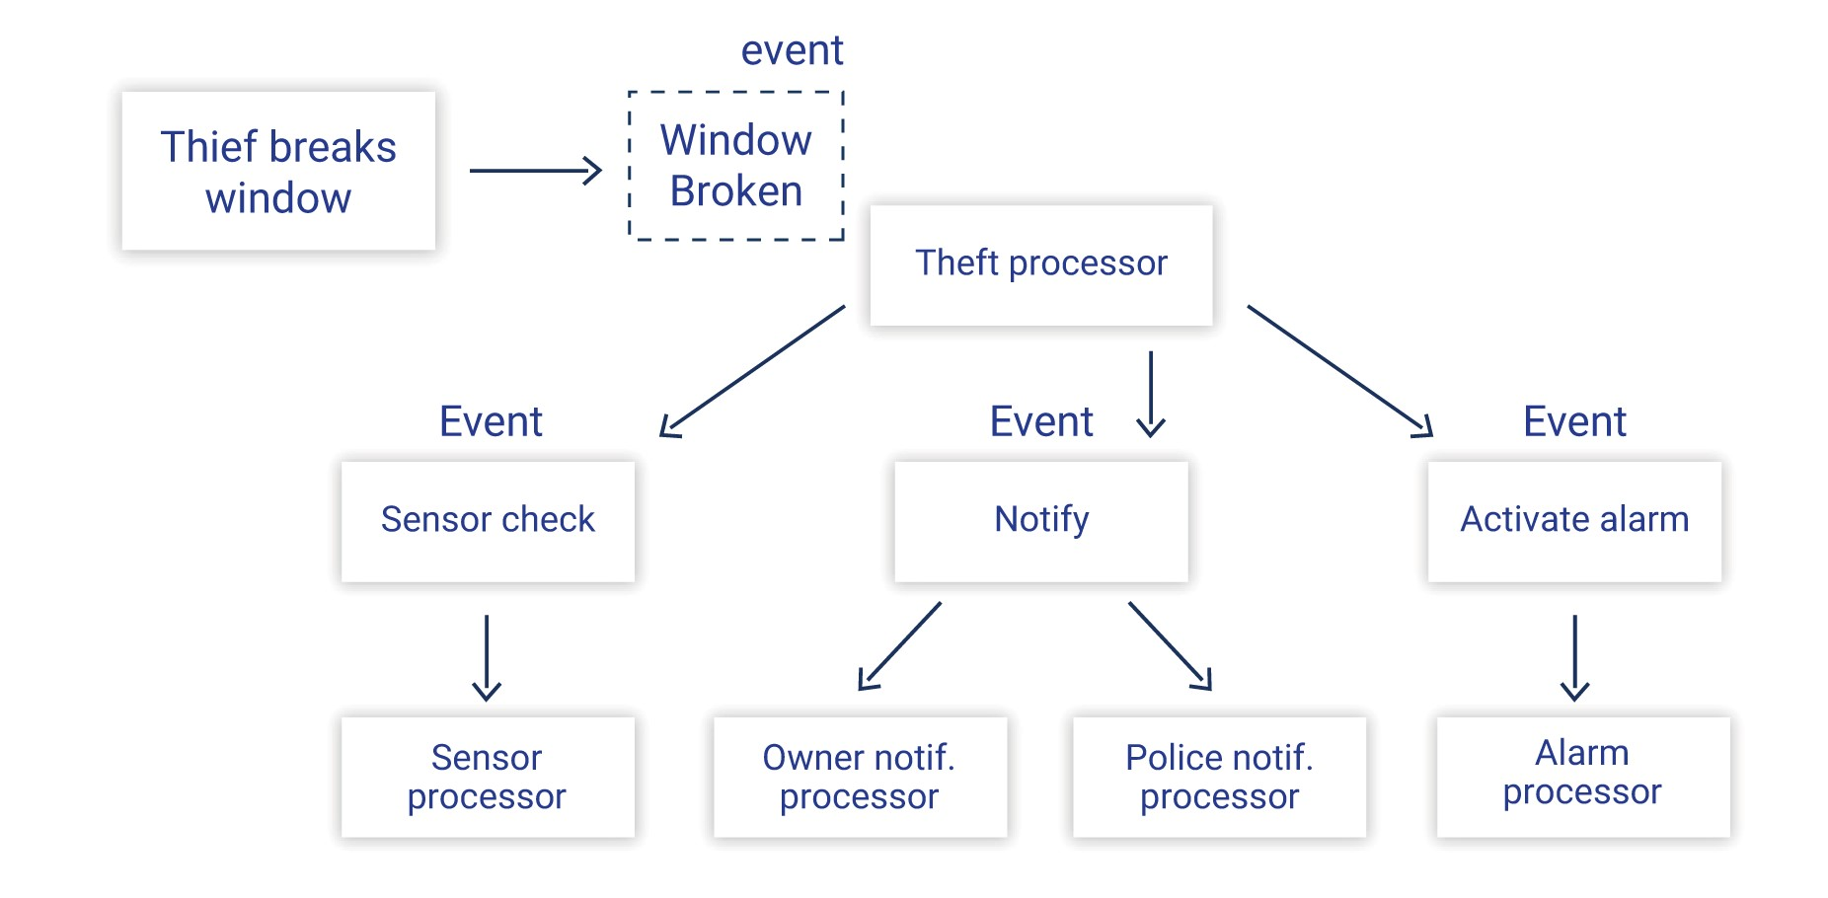
Broker Topology Example
Notes:
No coordination

Slide 25

Event Driven Architecture
Pros
Loose coupling – event producers and consumers are completely independent and can evolve separately
Event consumers and producers can be replaced seamlessly
No single point of failure
Less technical load – no server constantly listening for requests
Scales well
Cons
Can be overly complicated to design and understand
Difficult to debug due to inconsistent, asynchronous behaviour

Slide 26
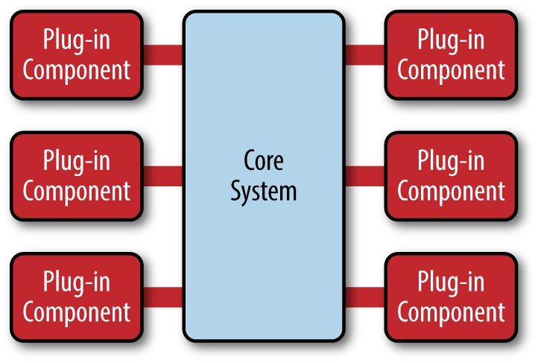
Microkernel architecture
The microkernel architecture, also known as the plug-in architecture, consists of two types of components
The core system contains the minimum functionality required to make the
The plug-in components are independent, stand-alone components that extend the functionality of the core system
Example: IDE (like VSCode, Eclipse
Core system of the IDE handles the basic functionality
Plug-in components add extra functionality

Slide 27

Microkernel architecture
Microkernel architecture is frequently used as part of another architecture
e.g. replacing one of the layers in a multi-tier architecture with a microkernel
Simplicity and extensibility make the microkernel architecture a great starting point for any product-based software

Slide 28

Microkernel architecture
Pros
Lends itself to agile development
Easy to deploy plug-ins
Plug-ins can be tested easily due to their stand-alone nature
Microkernel systems lend themselves to better performance
Cons
Difficult to scale, as major modifications cannot be made to the core system without affecting every plug-in
Can be difficult to develop

Slide 29
Microservices
The microservices architecture divides a system into a number of seperately deployed, independent service components
Service components are highly specialised, isolated units that serve a single function
Services are fully decoupled, and must be accessed via remote access protocols (like REST or SOAP)
The microservices architecture is a stripped-down, simplified version of a service-based architecture (SOA)
Microservices architectures differ by their topologies
API
Application
Centralised
Notes:
Topology: configuration

Slide 30
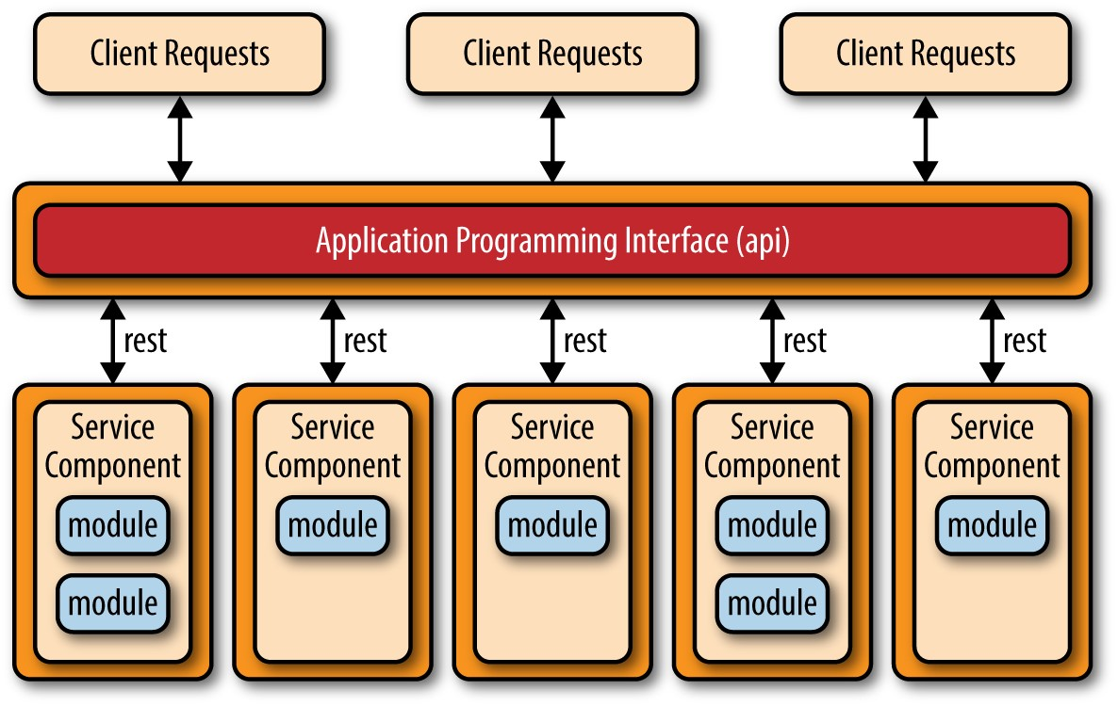
Microservices
API Topology
organized around their exposed APIs (Application Programming Interfaces)
Isolated services accessed via an API
Services communicate with each other primarily through these APIs, often using HTTP or other protocols like gRPC
Commonly used by Google and Amazon web services
emphasizes the decoupling of services and enables flexibility in scaling, deployment, and maintenance.
Notes:
In an API topology, microservices are organized around their exposed APIs (Application Programming Interfaces). Each microservice typically represents a specific business function or capability and exposes its functionality through a well-defined API.

Slide 31
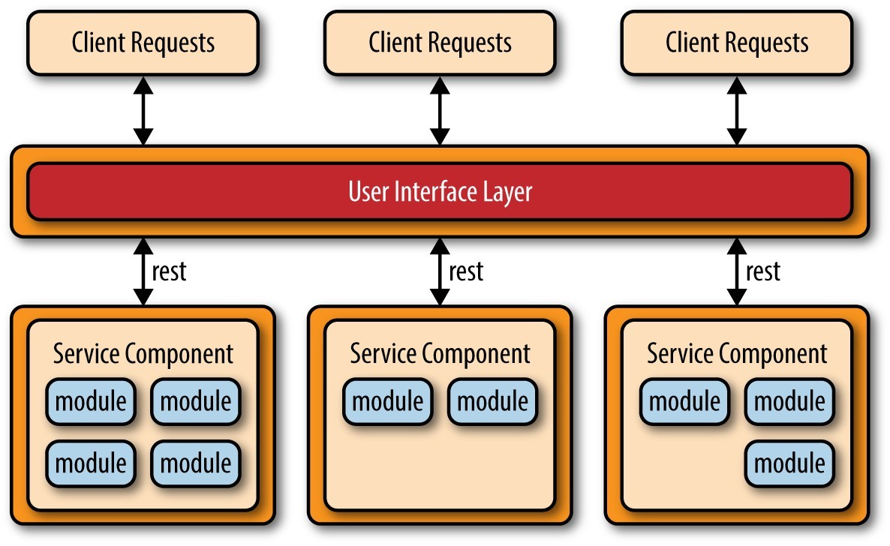
Microservices
Application Topology
microservices are organized based on their roles or responsibilities within the overall application.
Services accessed by a traditional client application rather than a lightweight API
Services tend to be larger, representing portions of a business application rather than single action services
Notes:
In an application topology, microservices are organized based on their roles or responsibilities within the overall application. Each microservice encapsulates a portion of the application's functionality, which may include multiple APIs or services
Services in an application topology might still expose APIs for external consumption, but the primary focus is on the internal structure of the application and how its components interact with each other

Slide 32
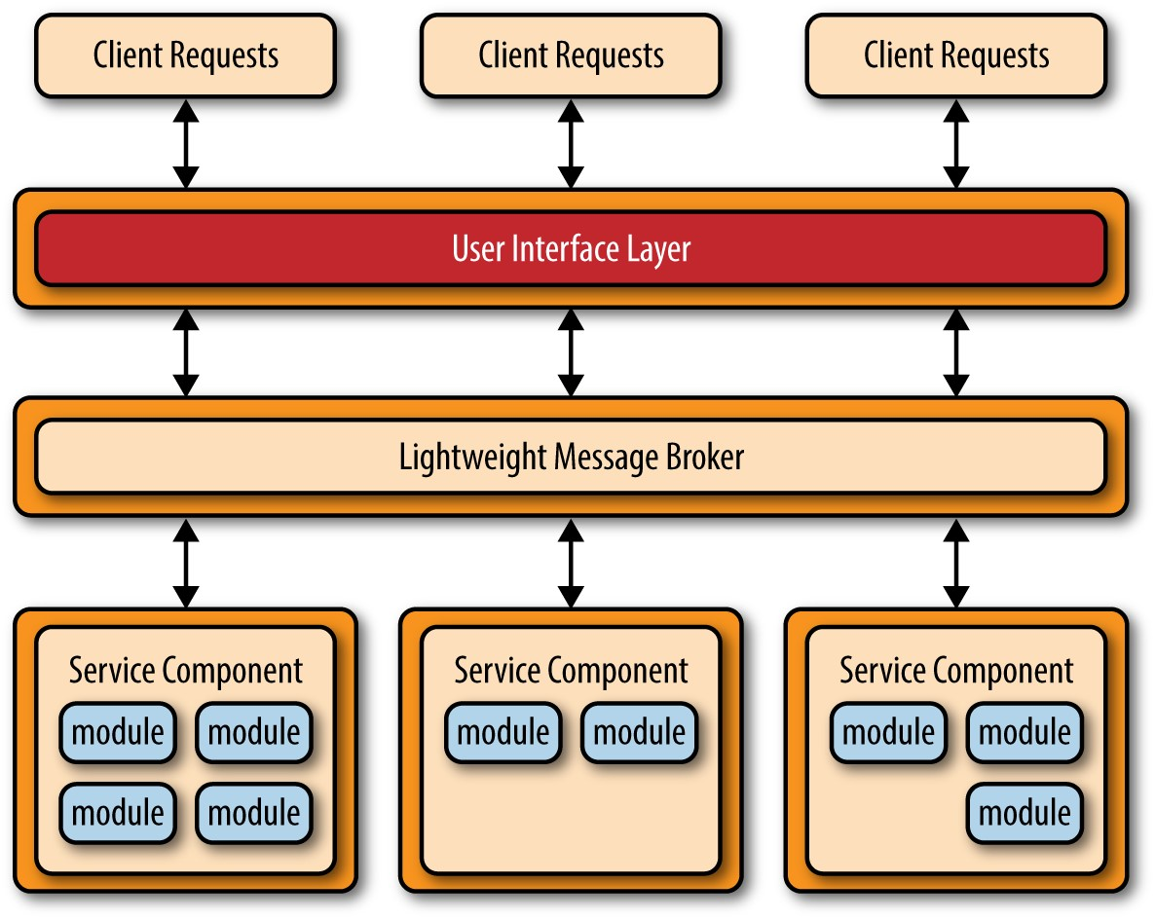
Microservices
Centralised Topology
Access to services mediated by a lightweight message broker
Allows greater control over services
Can better spread the load of service accesses
However, introduces a single point of failure

Slide 33
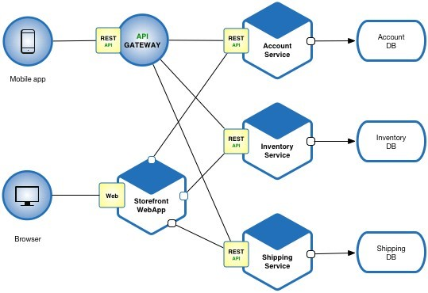
Microservices
Example: an e-commerce application

Slide 34
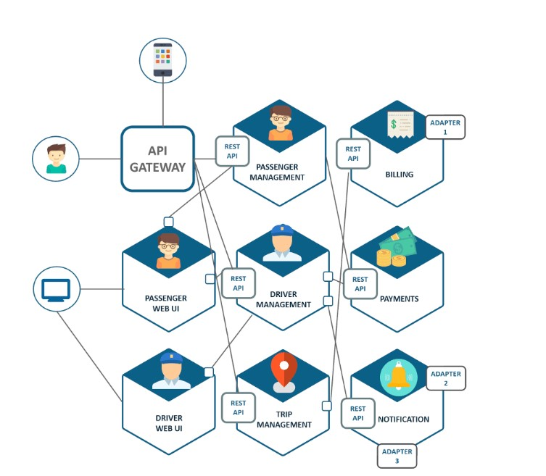
Microservices
Example: Uber architecture
Microservices handle functions like billing, trip management, notifications, etc.
Individual services are deployed to multiple regions to improve accessibility
Results in a complex web of microservices

Slide 35
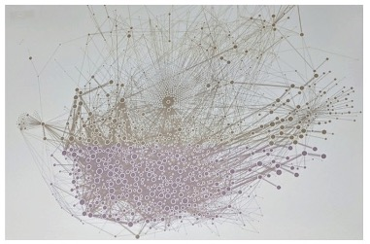
Microservices
Example: Uber architecture
Uber microservices ca. 2019

Slide 36
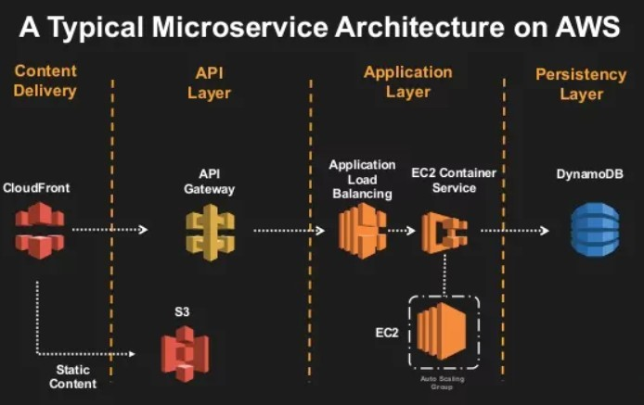
Microservices
When designing services, consider the level of granularity you want
If your services are too big, the architecture can tend towards being monolithic
If your services are too small, then they may require too much central control
Share data via shared databases and functionality by reused code
Each service can have its own architecture
Notes:
Often better to share data via shared databases and functionality by reused code rather than increase coupling via service communications

Slide 37
Microservices
Cons
Can be difficult to optimise performance due to the high reliance on message passing
Not well suited to small applications
Hard to test the entire system’s behaviour
Can be costly to set up an entire system of services
Pros
Easy to incorporate into an agile methodology
Easy to deploy as each service can be deployed and maintained separately
Easy to test each individual service
Scales very well – each individual service can be scaled according to demand
Easy to develop – separate teams can focus on separate services
Robust to failure of individual services

Slide 38


